Slide 1
Wetlands: Our natural safeguard against disasters
Ramsar Convention on Wetlands

Slide 2
World Wetlands Day 2017 – get involved!
Celebrated every 2 February to mark the adoption of the Ramsar Convention in Iran in 1971
Ways you can participate:
Visit a wetland site near you
Organize a wetland clean-up
Enter the photo contest (open to contestants aged 18-25)
Take a photo in a wetland location between 2 February and 2 March 2017 and upload it to www.worldwetlandsday.org
Educate others about the importance of wetlands
Register and upload your event to www.worldwetlandsday.org

Slide 3
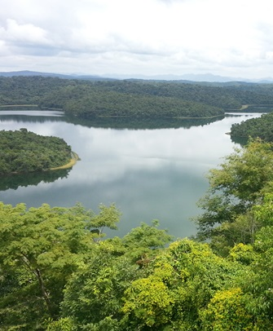
Ramsar Convention on Wetlands: Working to reverse wetland loss and degradation
Only global treaty to focus on a single ecosystem
Adopted in Ramsar, Iran in 1971
Parties commit to designating protected wetland Ramsar Sites, wise use of wetlands and cooperation on transboundary issues
Number of Member Country Contracting Parties: 169
Number of Ramsar Sites: 2,243
Total surface of designated Sites: 216,338,080 ha (slightly larger than Mexico)
www.ramsar.org/sites-countries/the-ramsar-sites

Slide 4
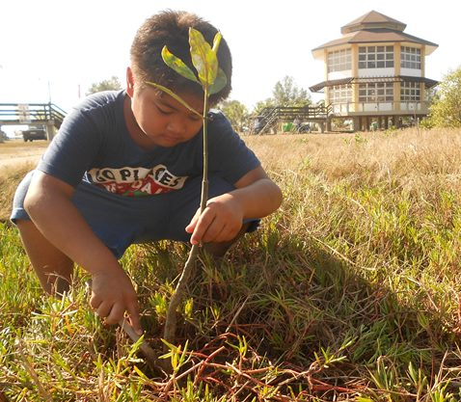
Ramsar Convention on Wetlands: Partner for sustainable development & disaster resilience
Ramsar Convention Strategic Plan contributes to 16 different SDGs; many part of managing disaster risk:
Goal 9: Build resilient infrastructure
Goal 13: Combat climate change
Goal 15: Protect, restore and promote sustainable use of terrestrial ecosystems
Support the four priorities of Sendai Framework for Disaster Risk Reduction 2015-2030
Understanding disaster risk
Strengthening disaster risk governance
Investing in disaster risk reduction for resilience
Enhancing disaster preparedness for effective response and to “Build Back Better”
Mangrove planting, Balanga City Wetland Park, Philippines

Slide 5
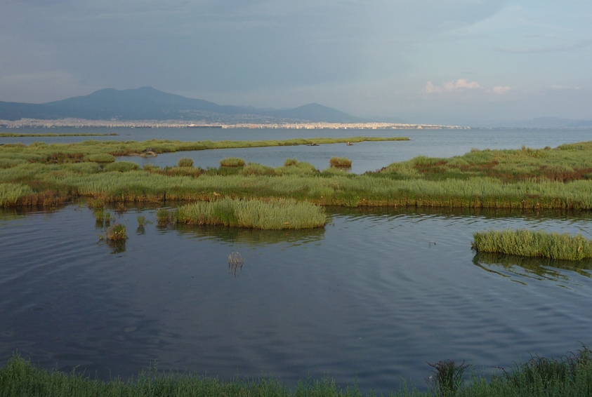
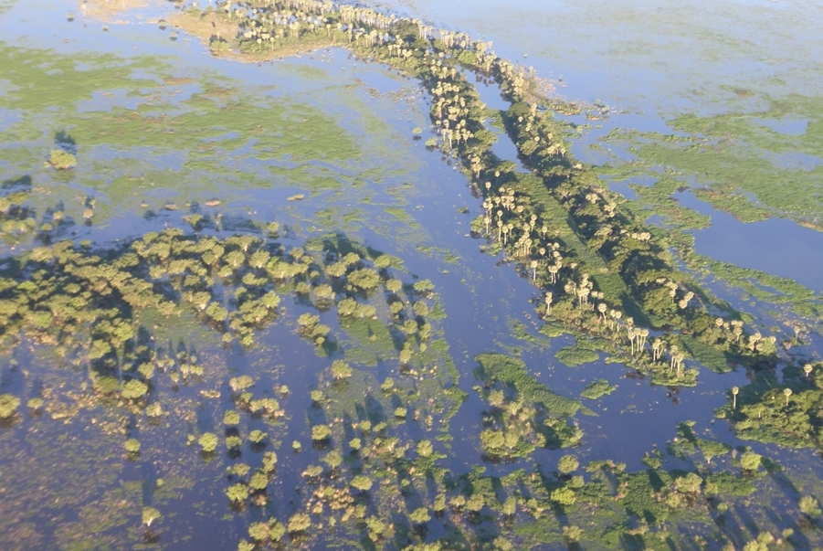
Wetlands: on the forefront against extreme weather events
Definition: land areas that are flooded with water, either seasonally or permanently and include:
Coastal wetlands:
mangroves, salt marshes, estuaries, coral reefs
barrier against waves, absorb part of storm surges
protect land from erosion
Inland wetlands:
rivers & floodplains, swamps/marshes, peatlands
slow and absorb water flows, lessen damage from floods
lessen drought
Many types store carbon against climate change.

Slide 6
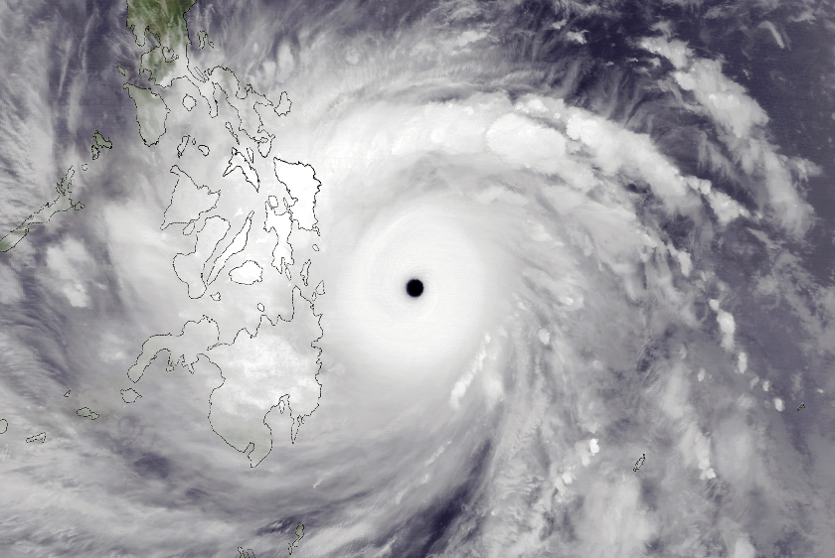
Background terminology: hazards v. disasters
Natural hazard:
Naturally-occurring event that could have a negative effect on humans
Includes floods, droughts earthquakes, tsunamis, cyclones/hurricanes, dust storms & other extreme events
Typhoon Haiyan nearing the Philippines, 7 November 2013
Picture: Wikipedia

Slide 7
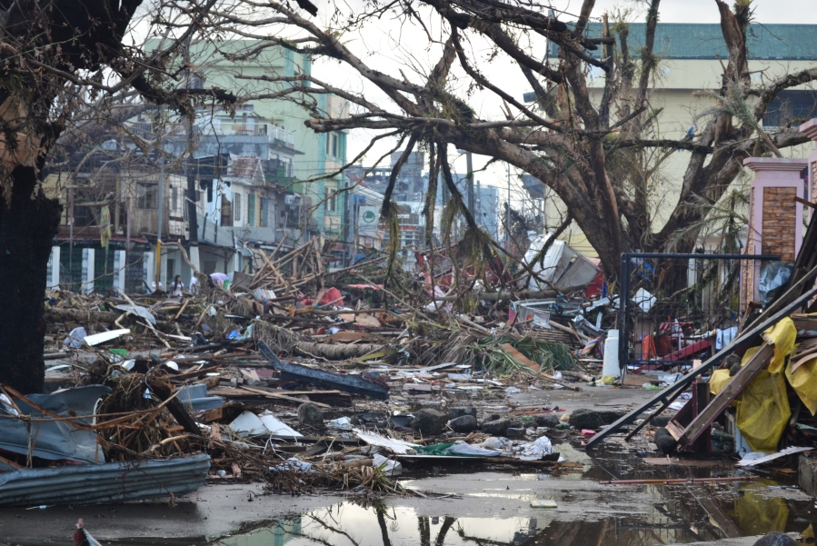
Background terminology: hazards v. disasters
Disaster:
Severe disruption that is caused to a community or nation in human, material, economic or environmental losses
The effect when a natural hazard strikes
Humans can contribute to or reinforce disasters
Over abstraction of water leading to drought
Draining of wetlands/ De-forestation and in-filling leading to erosion & flooding down stream
Draining and burning of peatlands, releasing CO2
Tacloban, Philippines after Typhoon Haiyan, 2013
Picture: Wikipedia

Slide 8
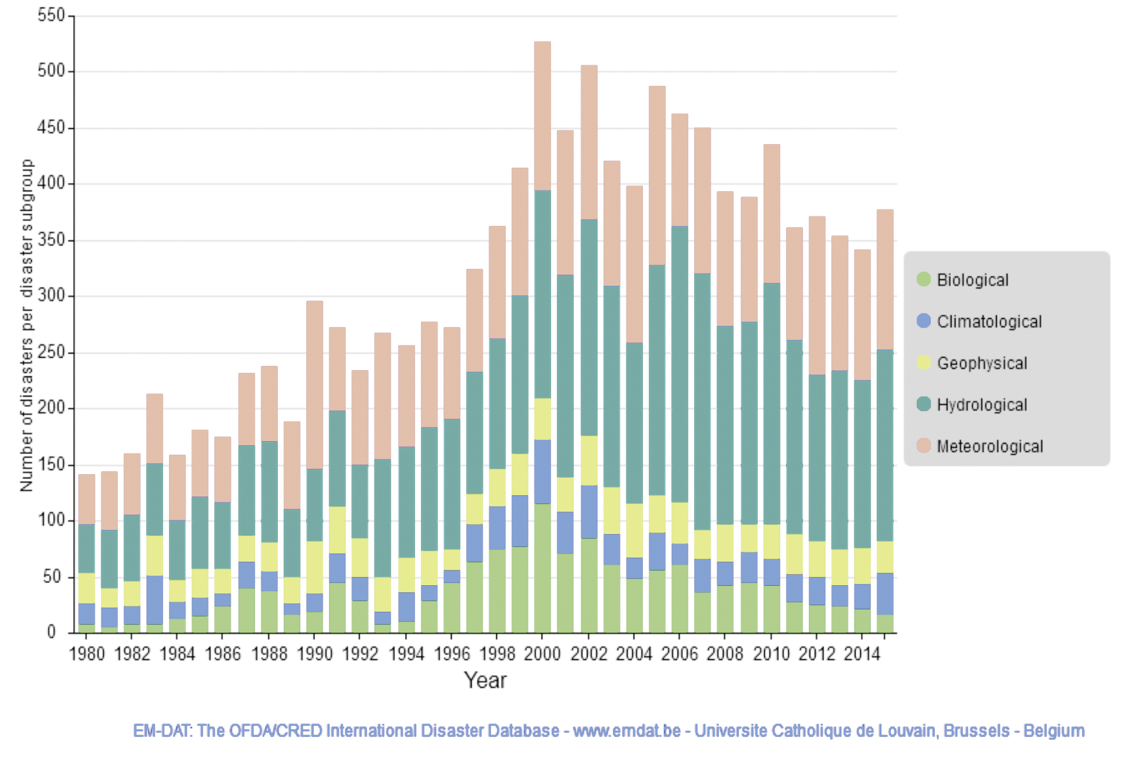
Disasters are growing more frequent
More than doubled in 35 years
Most of the increase comes from weather- and climate related events
Geological events have remained fairly steady
UN Water: 90% of all natural hazards are water-related

Slide 9
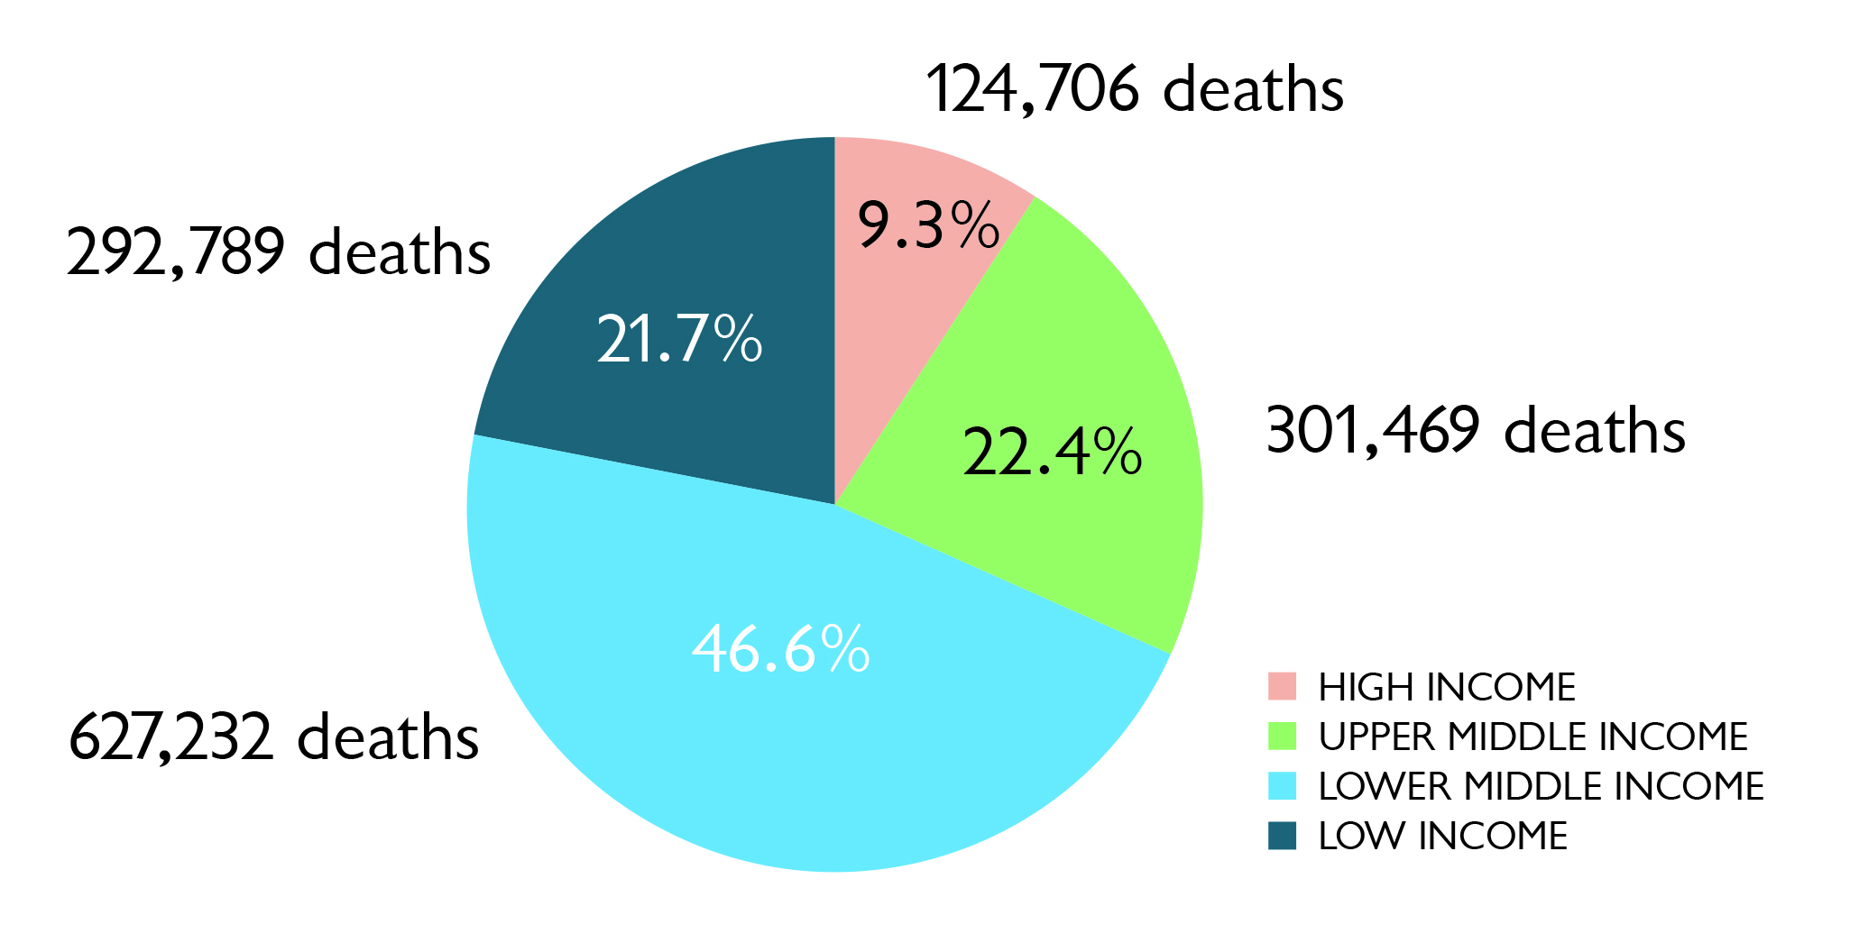
The losses are staggering
Disasters killed 1.35 million people worldwide from 1996-2015
Low and middle income countries account for 90% of fatalities
Economic losses: US$3.3 trillion from 1980-2014
Natural hazard fatalities by country income group 1996-2015
Statistics from Poverty & Death: Disaster & Mortality, CRED, 2016: p.12

Slide 10
Wetlands help before, during and after disasters:

Slide 11
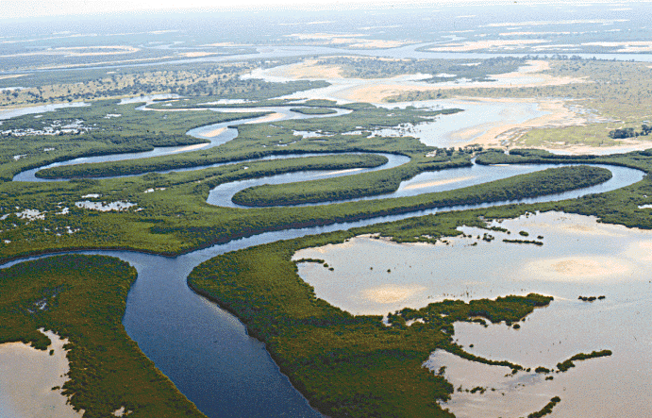
Wetlands help before disasters: Preparing/preventing
Beforehand, study & understand the risks posed by disasters
Designate storm- and flood-prone areas as protected wetlands
Example: Biosphere Reserve of the Saloum Delta, Senegal
Benefits
Controls flooding
Protects against coastal erosion
Provides freshwater year round
Saloum Delta, Senegal
Picture: Wikipedia

Slide 12
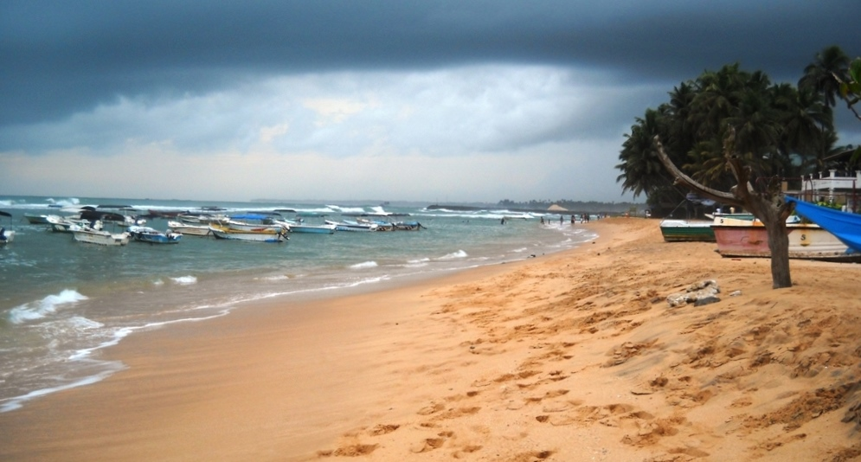
Wetlands during disasters: Coping
When disaster strikes, wetlands absorb some of the worst shock.
Example: Coral reefs in Sri Lanka during 2004 tsunami;
In Hikkaduwa, where coral reefs were protected: damage extended just 50m inland.
In nearby Peraliya, where coral mining had degraded reefs, damage extended 1.5 km inland.
Hikkaduwa Beach, Sri Lanka
Picture: Wikipedia

Slide 13
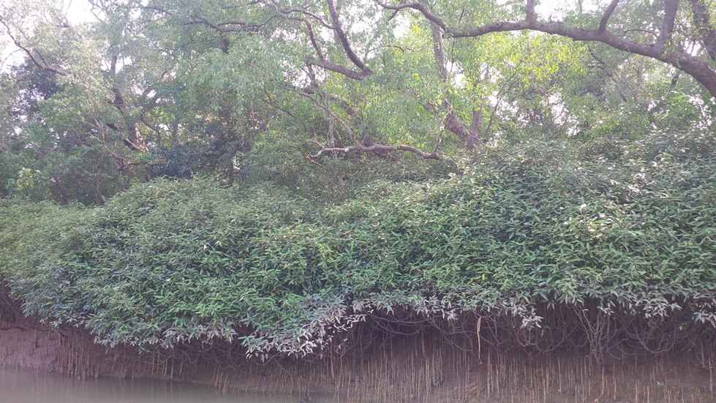
Wetlands after disasters: Bouncing back (“building back better”)
Enable quicker recovery.
Support biodiversity.
Ideal case: stronger than before disaster.
Example:
1999 cyclone that hit Odisha in eastern India.
Rice paddies protected by mangroves recovered food production much more quickly than unprotected croplands.
Bhitarkanika Mangroves in Odisha, India
Picture: Wikipedia

Slide 14
Five wetlands that help us cope with extreme events:

Slide 15
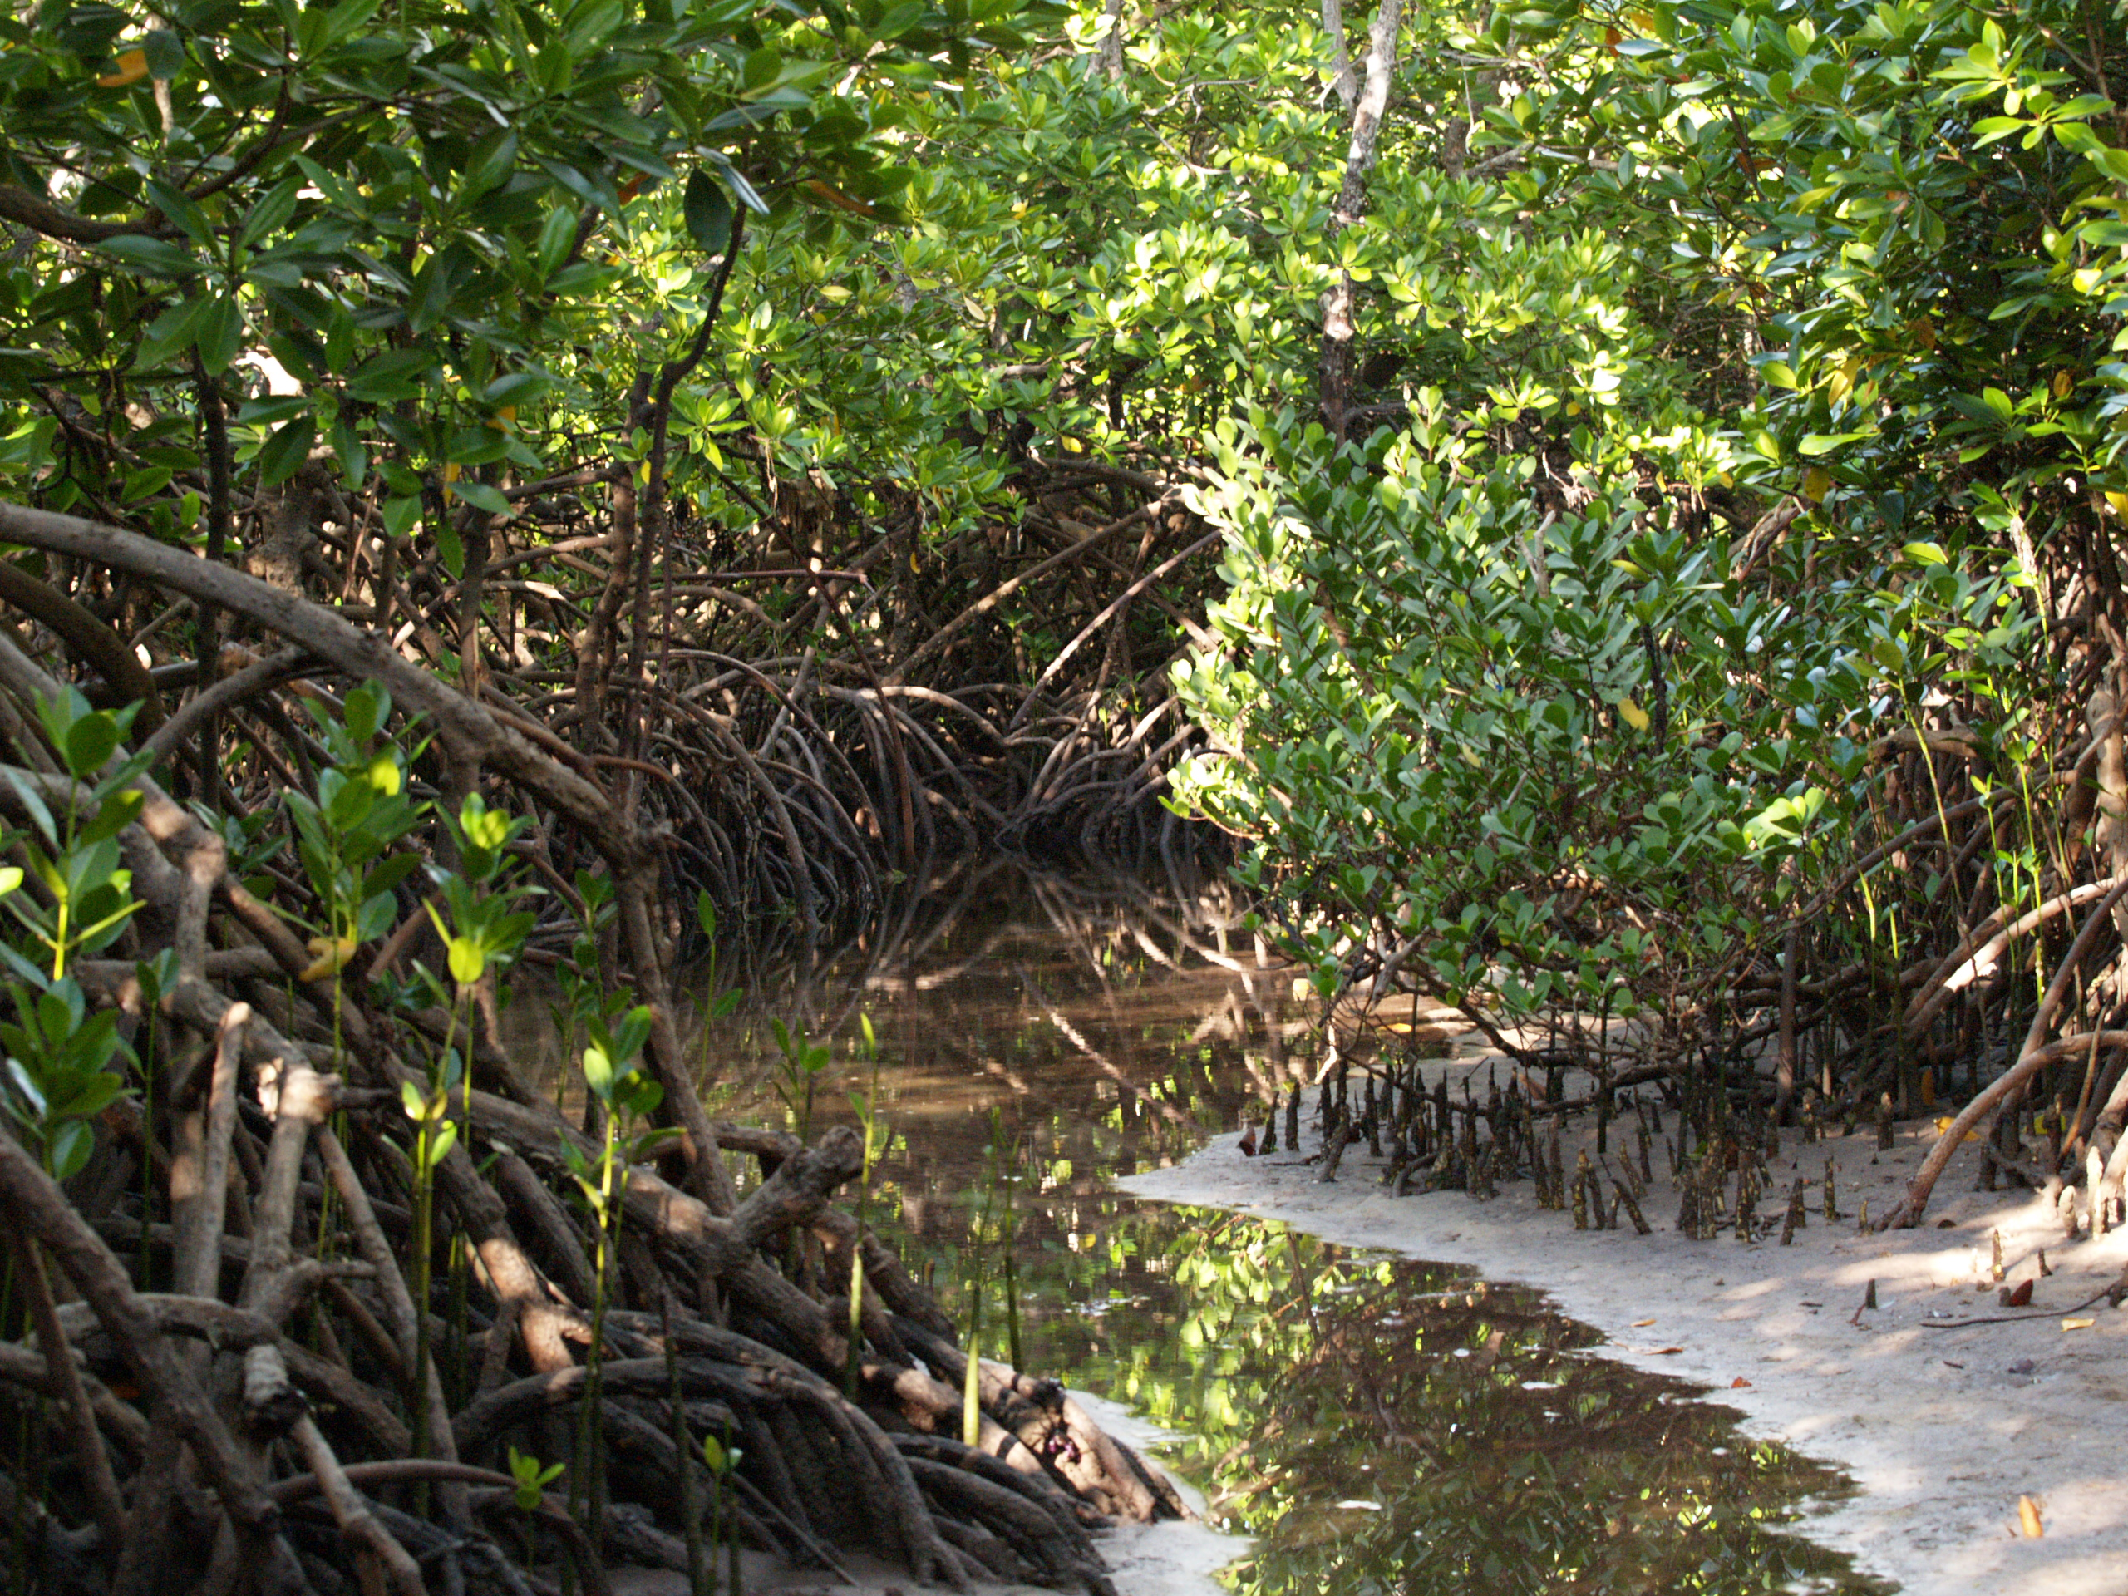
Five wetlands that help us cope with extreme events: 1. Mangroves
Salt-water tolerant shrubs and trees
Grow in shallow coastal waters, mostly in tropical, sub-tropical areas
Roots bind shore, prevent erosion
Each additional kilometer of mangrove forest can reduce the height of a storm surge by 50cm
Blunt effect of cyclones/hurricanes and tsunamis
Carbon-rich tropical forests
Each hectare worth up to $US 15,161 a year in disaster protection
Mangroves,Uzi Island, Zanzibar

Slide 16
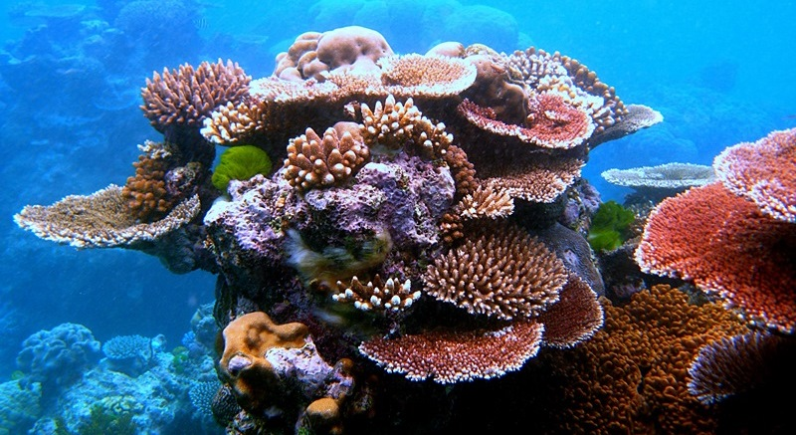
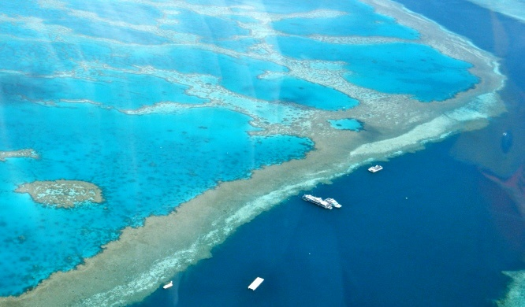
Five wetlands that help us cope with extreme events: 2. Coral reefs
Solid structures found in shallow tropical waters
Formed by living colonies of tiny coral polyps, building on exoskeletons of previous generations
Home to 25% of all marine species
Act as important offshore wave and surge barriers
Protection worth up to $US 33,556 per hectare/year
Small investment / huge effect:
US$1 million a year on restoring reefs at the Folkestone Marine Park on the west coast of Barbados could lower annual storm losses by US$20 million
Pictures: Wikipedia

Slide 17
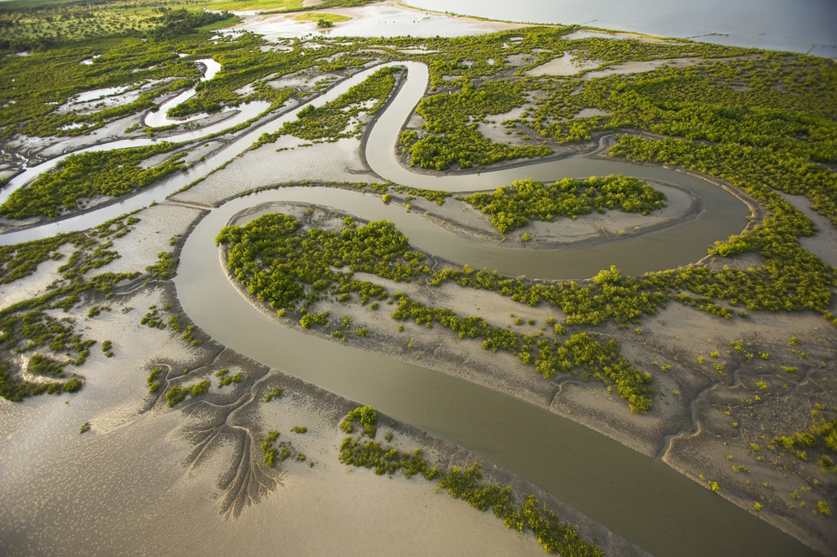
Five wetlands that help us cope with extreme events: 3. Rivers & flood plains
Rivers and streams meander to create fertile, silted floodplains
Left intact, along with their network of inland lakes and swamps, they can act as a giant reservoir
During intense rainfall or sudden floods, they can spread and store water over a wide area
Reduce damage downstream
Many rivers are canalized, especially near cities, eliminating this natural flood control
Casamance, Senegal

Slide 18
Five wetlands that help us cope with extreme events: 4. Inland deltas
When water flows into a wide, flat inland lake without draining into the ocean, an inland delta is formed
In extremely arid areas, these seasonal flows are a strong natural safeguard against drought
Okavango Delta in Botswana: annual flooding of an area the size of Belgium
home to 200,000 large mammals
400 bird species
safeguards against drought in dry winter
Okavango Delta, Botswana
Picture: Global Wetlands Africa

Slide 19
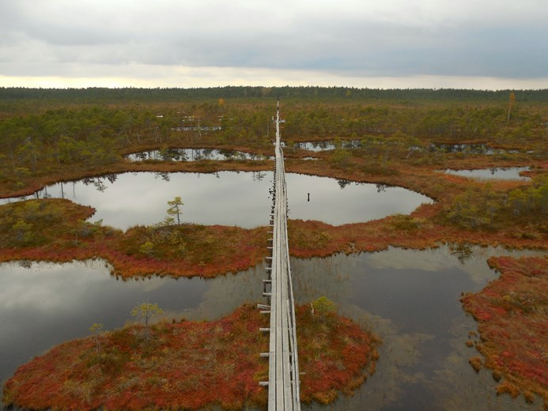
Five wetlands that help us cope with extreme events: 5. Peatlands
Water-saturated lands made of decomposed plant material, built up over time
up to 30 metres deep
also known as mires, bogs or moors
cover 3% of the earth’s land surface
Key fact: peatlands store more than twice as much carbon as all of the world’s forests combined:
vital way to mitigate some effects of climate change
Peatland in Estonia

Slide 20
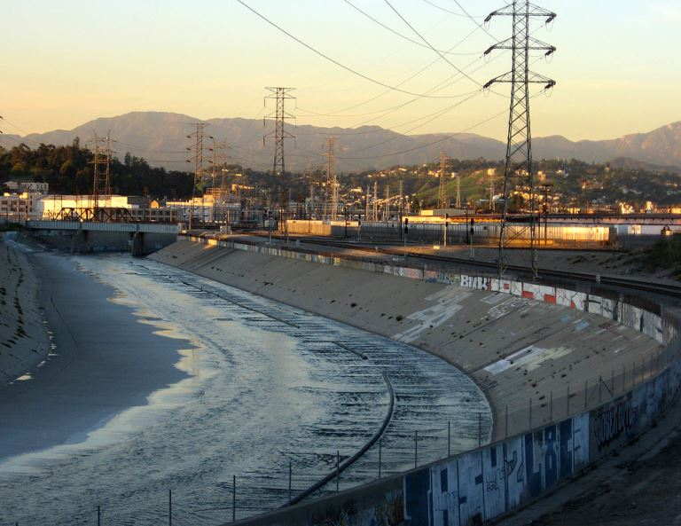
Mismanaging wetlands can make the impact from disasters worse
64% of wetlands have disappeared since 1900
Canalizing rivers can make floods more powerful
Clearing mangroves and mining coral reefs can expose coastlines to storms
Burning or draining peatlands releases large quantities of CO2
Los Angeles River, California, USA
Picture: Wikipedia

Slide 21
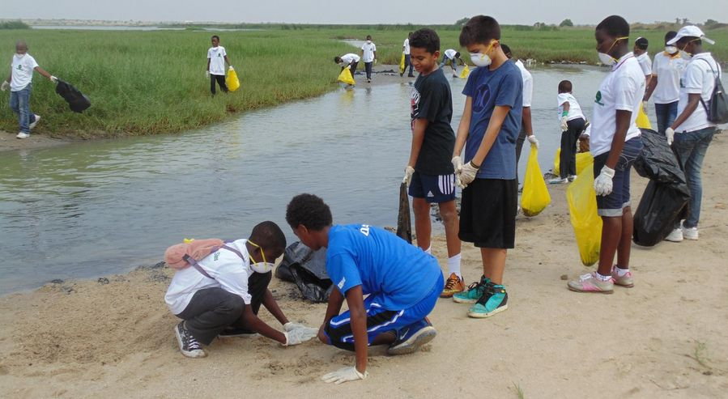
Wetlands: how can we take care of them? Communities:
Do a wetlands clean-up
Analyze how local wetlands are being used
Who depends on them?
Who uses what and when?
Adopt local policies to promote long-term sustainability, e.g.:
Practice sustainable fishing & agriculture
No-take rules; catch limits
Restrict construction in wetlands
Clean-up of a Ramsar Site in Ghana, 2015

Slide 22
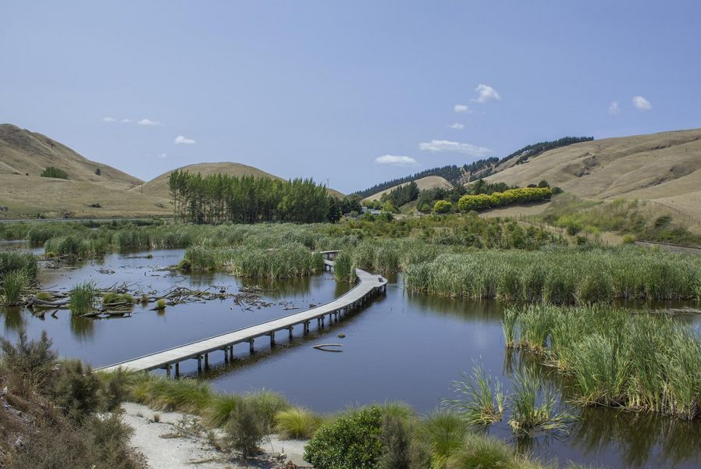
Wetlands: how can we take care of them? Policy-makers
Include wetlands in disaster planning strategy
Protect wetlands in flood and storm-prone areas
Restore degraded wetlands
Work with local actors to promote sustainable fishing, agriculture and tourism
Adopt cross sectoral policies especially in agriculture and water to help protect wetlands
Restored wetlands, Hastings, New Zealand

Slide 23
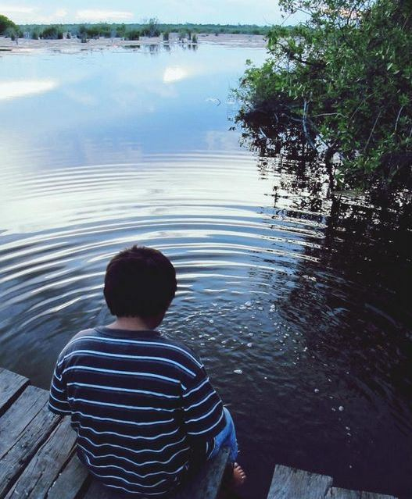
Wetlands: how can we take care of them? Individuals
Organize or join a wetland clean-up exercise
Become a Wetland Ambassador advocate for wetlands
Participate in actions to conserve and restore wetlands
Use non-toxic products that don’t pollute wetlands
Use water sparingly

Slide 24
World Wetlands Day 2017 – get involved!
Celebrated every 2 February to mark the adoption of the Ramsar Convention in Iran in 1971
Ways you can participate:
Visit a wetland site near you
Organize a wetland clean-up
Enter the photo contest (open to contestants aged 18-25)
Take a photo in a wetland location between 2 February and 2 March 2017 and upload it to www.worldwetlandsday.org
Educate others about the importance of wetlands
Register and upload your event to www.worldwetlandsday.org

Slide 25
Thank you!
Ramsar Convention on Wetlands
Rue Mauverney 28 | CH-1196 Gland | Switzerland
+41 22 999 01 70 | ramsar@ramsar.org

Slide 26
Sources
For official definition of disasters and hazards: United Nations Office for Disaster Risk Reduction website https://www.unisdr.org/we/inform/terminology
For chart of disaster frequency and type: OFDA/CRED International disaster database
http://www.emdat.be/disaster_trends/index.html
For percentage of water-related natural hazards:
UN Water website: Water-related hazards
http://www.unwater.org/topics/water-related-hazards/en/
For disaster fatalities by country development status:
Centre for Research on the Epidemiology of Disasters (CRED) / United Nations Office for Disaster Risk Reduction (UNISDR): Poverty & Death: Disaster Mortality 1996-2015 (pp. 05 and 12)
http://reliefweb.int/sites/reliefweb.int/files/resources/CRED_Disaster_Mortality.pdf
For disaster-related financial losses 1980-2014:
Munich RE/NatCat SERVICE:Loss events worldwide 1980 – 2014 (slide 10)
https://www.munichre.com/site/touch-naturalhazards/get/documents_E2080665585/mr/assetpool.shared/Documents/5_Touch/_NatCatService/Focus_analyses/1980-2014-Loss-events-worldwide.pdf
For Saloum Delta example:
IUCN/ Ministry of Environment (Japan)/ CEM: Protected Areas as Tools for Risk Reduction (p. 23)
http://reliefweb.int/sites/reliefweb.int/files/resources/2015-001.pdf
For coral reef damage example from Sri Lanka:
IUCN: Safe Havens – Protected Areas for Disaster Risk Reduction and Climate Change Adaptation, (p. ix)
https://www.iucn.org/sites/dev/files/2014-038.pdf
For post-cyclone recovery of rice production with mangrove protection:
IUCN/ Ministry of Environment (Japan)/ CEM: Protected Areas as Tools for Risk Reduction (p. 16)
http://reliefweb.int/sites/reliefweb.int/files/resources/2015-001.pdf
For mangrove reduction of storm surges:
Keqi Zhang et al., The role of mangroves in attenuating storm surges, (abstract)
http://www.sciencedirect.com/science/article/pii/S0272771412000674
For mangrove carbon storage:
Nature Geoscience 4, 293-297, Donato et. al: Mangroves among the most carbon-rich forests in the tropics
http://www.nature.com/ngeo/journal/v4/n5/abs/ngeo1123.html
For hectare per year value of disaster-related services provided by mangroves:
TEEB: The Economics of Ecosystems and Biodiversity for Water and Wetlands (p. 65)
http://www.ramsar.org/sites/default/files/documents/library/teeb_waterwetlands_report_2013.pdf
And for value of extreme events protection offered by coral reefs: (p. 63)
For potential effects of reef restoration in Barbados:
IUCN: Safe Havens – Protected Areas for Disaster Risk Reduction and Climate Change Adaptation (p. 19)
https://www.iucn.org/sites/dev/files/2014-038.pdf
For Okavango Delta information:
Ramsar website news: Okavango Delta Ramsar Site is now 1000th World Heritage Site
http://www.ramsar.org/news/okavango-delta-ramsar-site-is-now-1000th-world-heritage-site
For peatlands as percentage of earth’s land area:
International Peat Society: Peatlands and Climate Change (p.9)
http://www.peatsociety.org/sites/default/files/files/PeatlandsandClimateChangeBookIPS2008.pdf
For peatlands and carbon sequestration in relation to forests:
TEEB: The Economics of Ecosystems and Biodiversity for Water and Wetlands (p. 11)
http://www.ramsar.org/sites/default/files/documents/library/teeb_waterwetlands_report_2013.pdf

